Slide 1
Chapter 5:
Analog Transmission

Slide 2
Midterm Solution

Slide 3
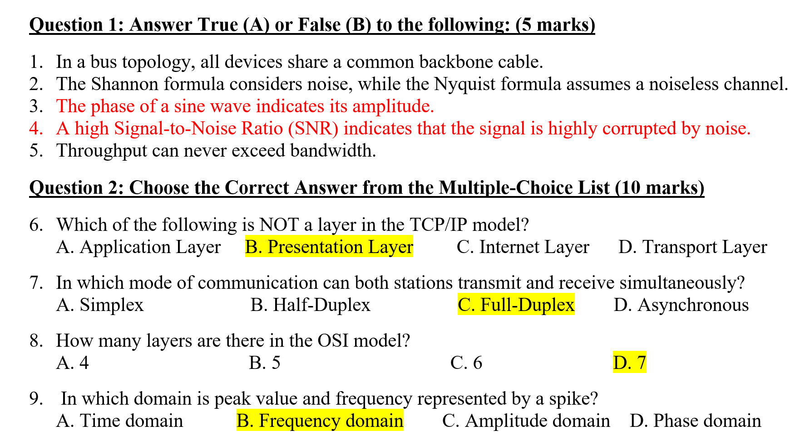

Slide 4
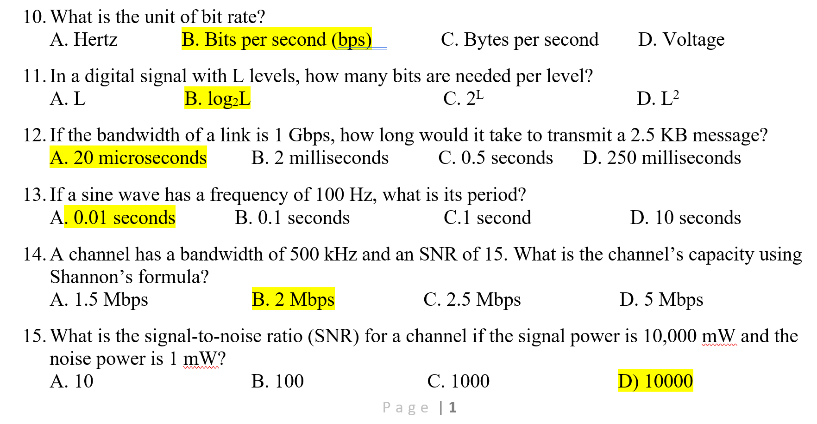

Slide 5
Revision

Slide 6
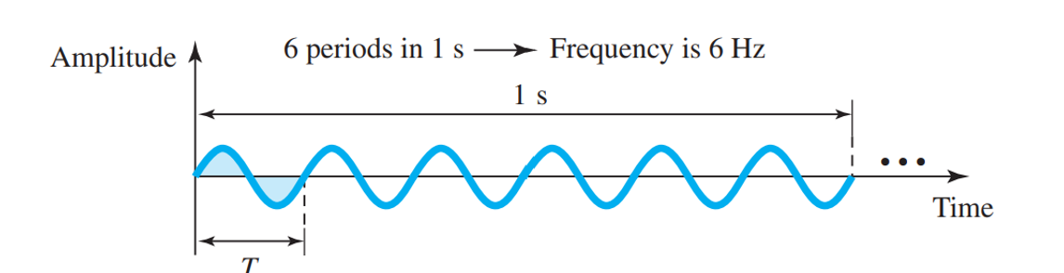
Sine Wave
A sine wave can be represented by three parameters:
  The peak amplitude of a signal is the absolute value of its highest intensity, proportional to the energy it carries.
  Frequency refers to the number of periods in 1 s.
  Phase describes the position of the waveform relative to time 0.

Slide 7
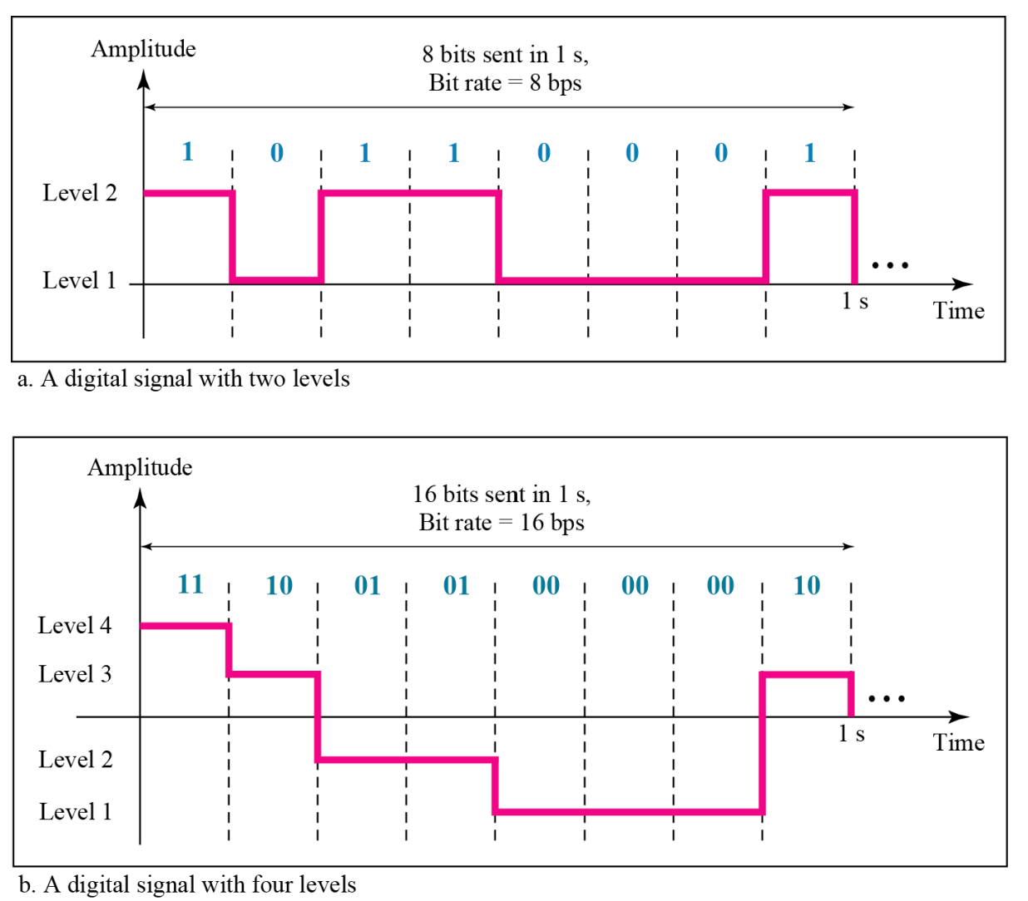
Two digital signals: one with two signal levels and the other with four signal levels

Slide 8
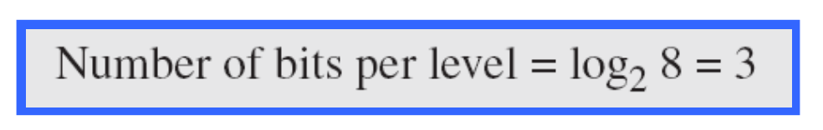
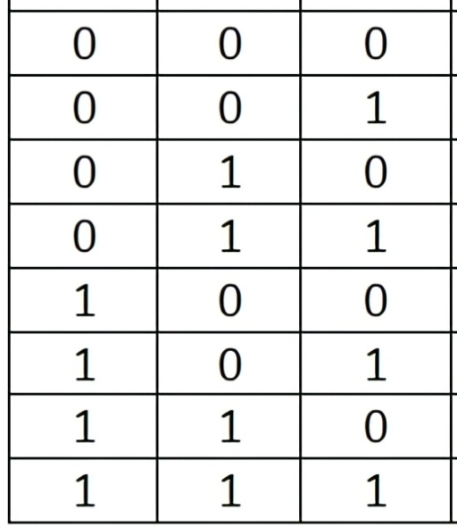
Example
A digital signal has eight levels. How many bits are needed per level?
Each signal level is represented by 3 bits.

Slide 9
Signal Element Versus Data Element
A data element is the smallest entity that can represent a piece of information: this is the bit.
A signal element is the shortest unit (timewise) of a digital signal.
In other words, data elements are what we need to send; signal elements are what we can send.
Data elements are being carried; signal elements are the carriers.

Slide 10
Data Rate Versus Signal Rate
The data rate
  defines the number of data elements (bits) sent in 1s.
  The unit is bits per second (bps).
  The data rate is sometimes called the bit rate;
The signal rate
  is the number of signal elements sent in 1s.
  The unit is the baud.
  the signal rate is sometimes called the pulse rate, the modulation rate, or the baud rate.

Slide 11
Agenda
DIGITAL-TO-ANALOG CONVERSION
  Amplitude Shift Keying
  Frequency Shift Keying
  Phase Shift Keying
  Quadrature Amplitude Modulation (QAM)

Slide 12
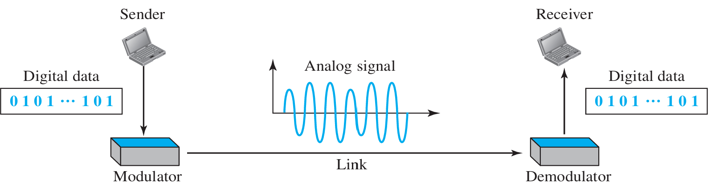
DIGITAL-TO-ANALOG CONVERSION
Digital-to-analog conversion is the process of changing one of the characteristics of an analog signal based on the information in digital data.

Slide 13
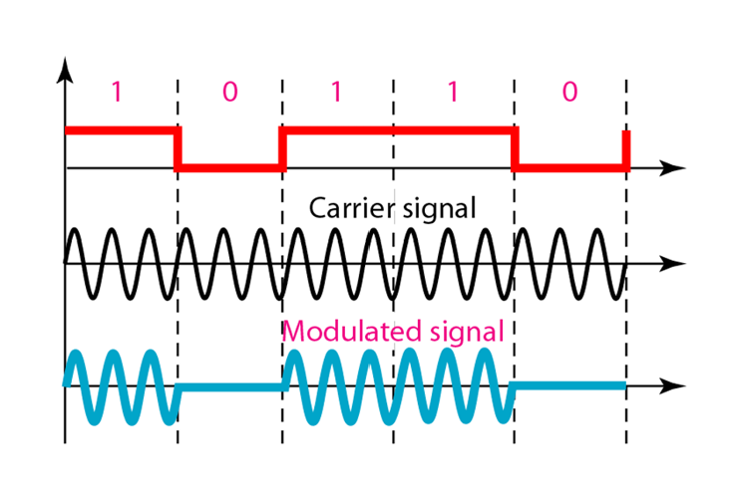
Carrier Signal
In analog transmission, the sending device produces a high-frequency signal that acts as a base for the information signal.
This base signal is called the carrier signal or carrier frequency.
The receiving device is tuned to the frequency of the carrier signal that it expects from the sender.
Digital information then changes the carrier signal by modifying one or more of its characteristics (amplitude, frequency, or phase).
This kind of modification is called modulation (shift keying).

Slide 14
Sine wave
Sine wave is defined by three characteristics: amplitude, frequency, and phase.
When we vary any one of these characteristics, we create a different version of that wave.
So, by changing one characteristic of a simple electric signal, we can use it to represent digital data.

Slide 15
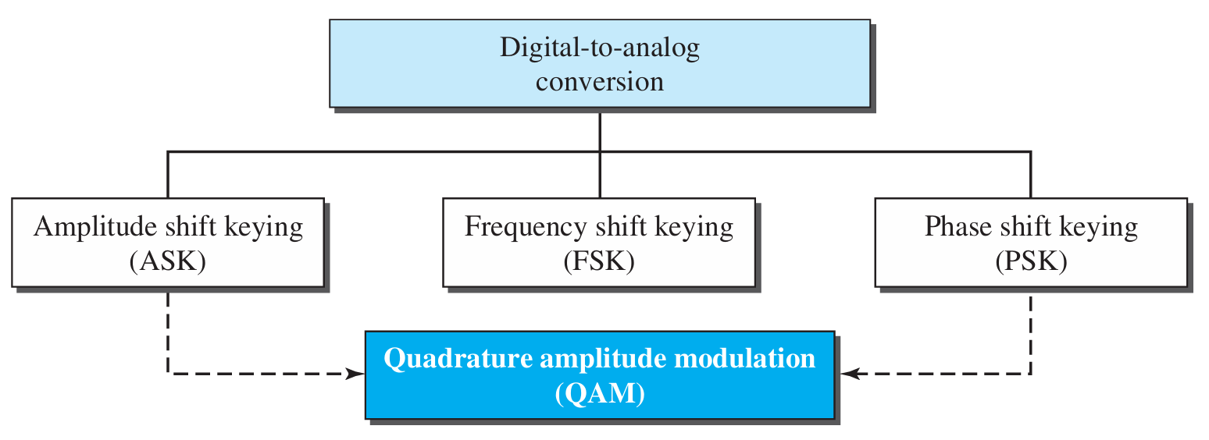
Types of digital-to-analog conversion

Slide 16
Aspects of Digital-to-Analog Conversion
Data element is the smallest piece of information to be exchanged, the bit.
Signal element is the smallest unit of a signal.
Bit rate is the number of bits per second.
Baud rate is the number of signal elements per second.
In the analog transmission of digital data, the baud rate is less than or equal to the bit rate.

Slide 17
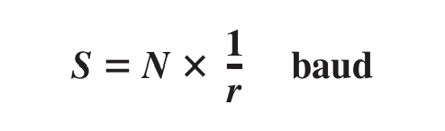
Data Rate Versus Signal Rate
The relationship between S and N
where N is the data rate (bps) and r is the number of data elements carried in one signal element.
The value of r in analog transmission is r = log₂ L, where L is the number of different signal elements.
In transportation, a baud is analogous to a vehicle, and a bit is analogous to a passenger.
We need to maximize the number of people per car to reduce the traffic.

Slide 18
Example
An analog signal carries 4 bits per signal element. If 1000 signal elements are sent per second, find the bit rate.
Solution
In this case, r = 4, S = 1000, and N is unknown. We can find the value of N from

Slide 19
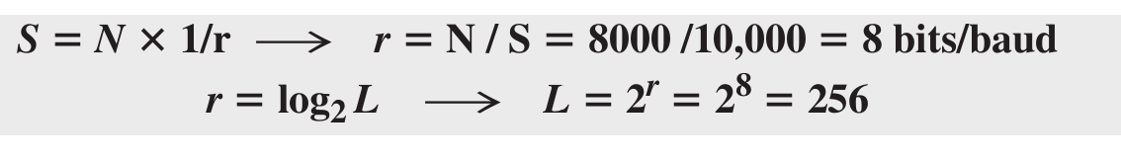
Example
An analog signal has a bit rate of 8000 bps and a baud rate of 1000 baud.
How many data elements are carried by each signal element? How many signal elements do we need?
Solution
In this example, S = 1000, N = 8000, and r and L are unknown. We first find the value of r and then the value of L.

Slide 20
Amplitude Shift Keying
In amplitude shift keying, the amplitude of the carrier signal is varied to create signal elements.
Both frequency and phase remain constant while the amplitude changes.

Slide 21
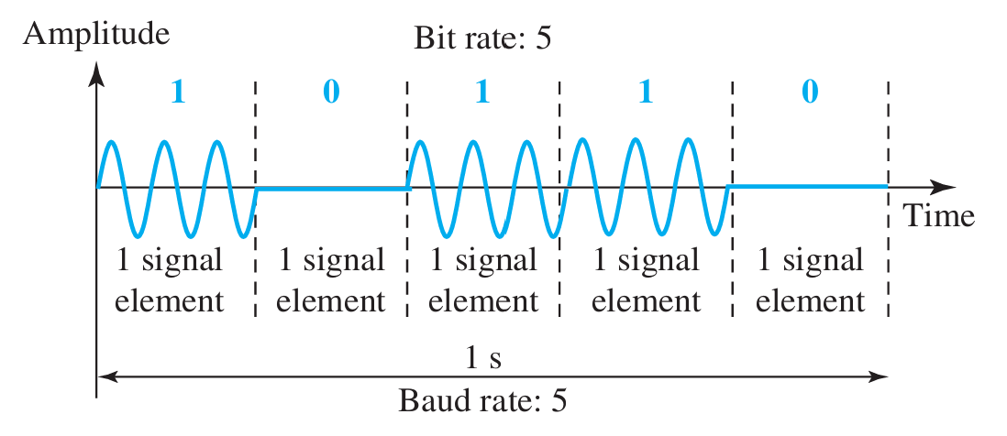
Binary ASK (BASK)
Although we can have several levels (kinds) of signal elements, each with a different amplitude, ASK is normally implemented using only two levels.
This is referred to as binary amplitude shift keying or on-off keying (OOK).
The peak amplitude of one signal level is 0; the other is the same as the amplitude of the carrier frequency.

Slide 22
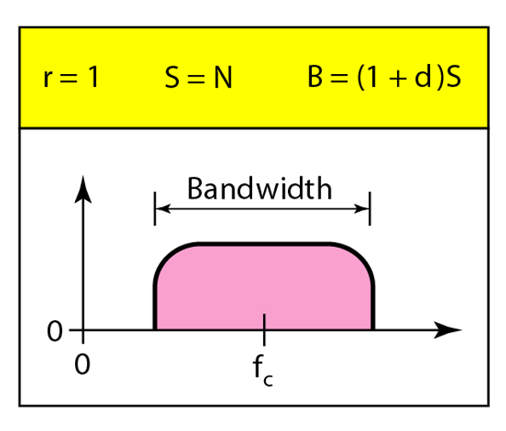
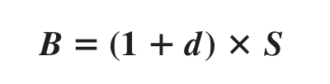
Bandwidth for ASK
This means that the bandwidth can be expressed as shown, where S is the signal rate and the B is the bandwidth.
there is normally another factor involved, called d, which depends on the modulation and filtering process.
The value of d is between 0 and 1.

Slide 23
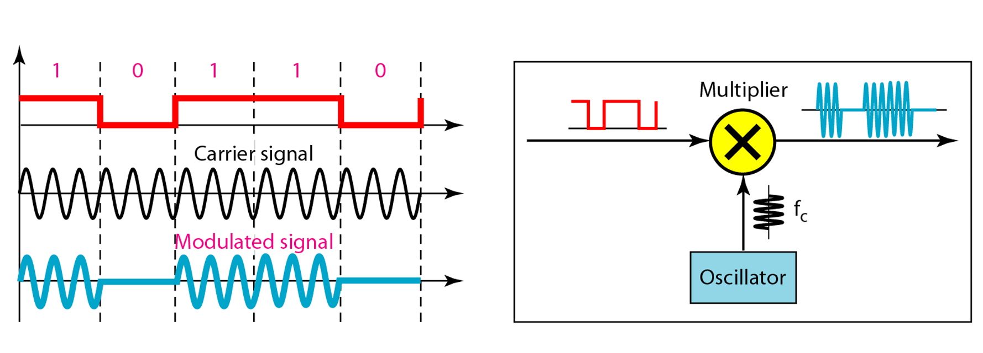
Implementation of binary ASK
Notes:
the carrier signal coming from an oscillator. When the amplitude of the NRZ signal is 1, the amplitude of the carrier frequency is held; when the amplitude of the NRZ signal is 0, the amplitude of the carrier frequency is zero.

Slide 24
Example
We have an available bandwidth of 100 kHz which spans from 200 to 300 kHz. What are the carrier frequency and the bit rate if we modulated our data by using ASK with d = 1?
Solution
The middle of the bandwidth is located at 250 kHz.
This means that our carrier frequency can be at f_{c} = 250 kHz. We can use the formula for bandwidth to find the bit rate (with d = 1 and r = 1)

Slide 25
Example
In data communications, we normally use full-duplex links with communication in both directions.
We need to divide the bandwidth into two with two carrier frequencies, as shown in Figure 5.5.
The figure shows the positions of two carrier frequencies and the bandwidths.
The available bandwidth for each direction is now 50 kHz, which leaves us with a data rate of 25 kbps in each direction.

Slide 26
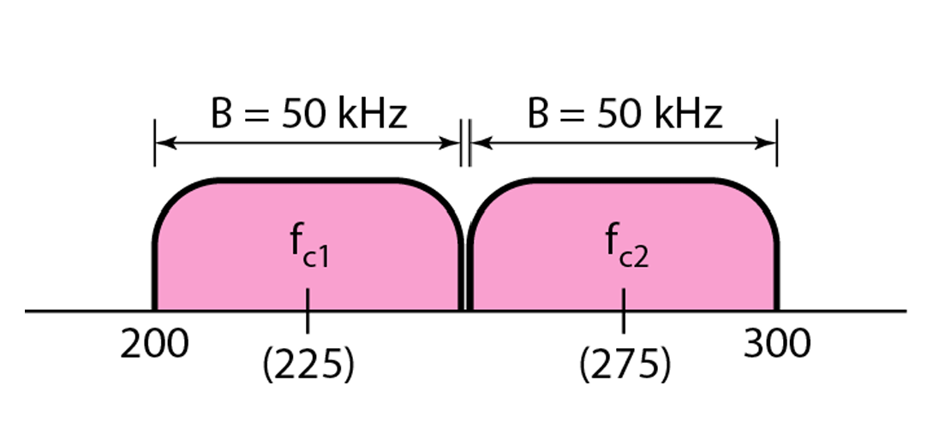
Bandwidth of full-duplex ASK used in Example
50 = 2 * N
N = 25

Slide 27
Frequency Shift Keying
In frequency shift keying, the frequency of the carrier signal is varied to represent data.
The frequency of the modulated signal is constant for the duration of one signal element, but changes for the next signal element if the data element changes.
Both peak amplitude and phase remain constant for all signal elements.
Notes:
23

Slide 28
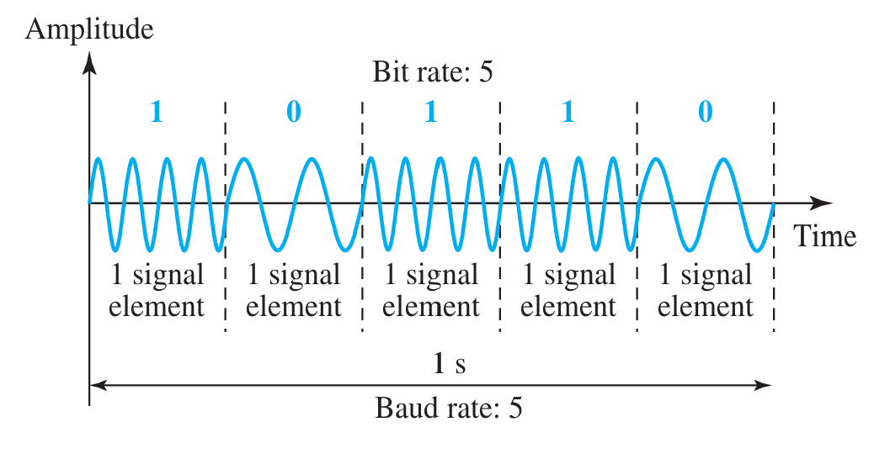
Binary FSK (BFSK)

Slide 29
Binary FSK (BFSK)
One way to think about binary FSK (or BFSK) is to consider two carrier frequencies.
We have selected two carrier frequencies, f1 and f2.
We use the first carrier if the data element is 0; we use the second if the data element is 1.
Normally the carrier frequencies are very high, and the difference between them is very small.

Slide 30
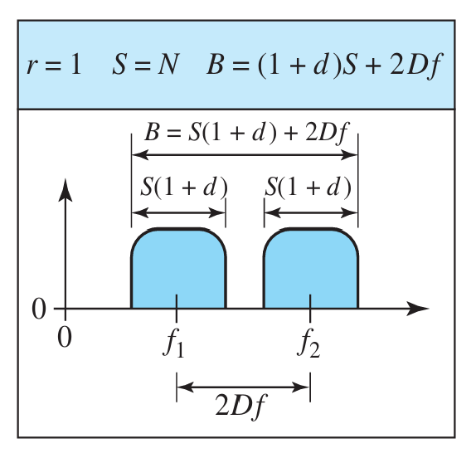

Bandwidth for BFSK
We can think of FSK as two ASK signals, each with its own carrier frequency (f1 or f2).
If the difference between the two frequencies is 2Δf, then the required bandwidth is

Slide 31
Example
We have an available bandwidth of 100 kHz which spans from 200 to 300 kHz. What should be the carrier frequency and the bit rate if we modulated our data by using FSK with d = 1?

Slide 32
Solution
The midpoint of the band is at 250 kHz.
We choose 2Δf to be 50 kHz; this means.

Slide 33
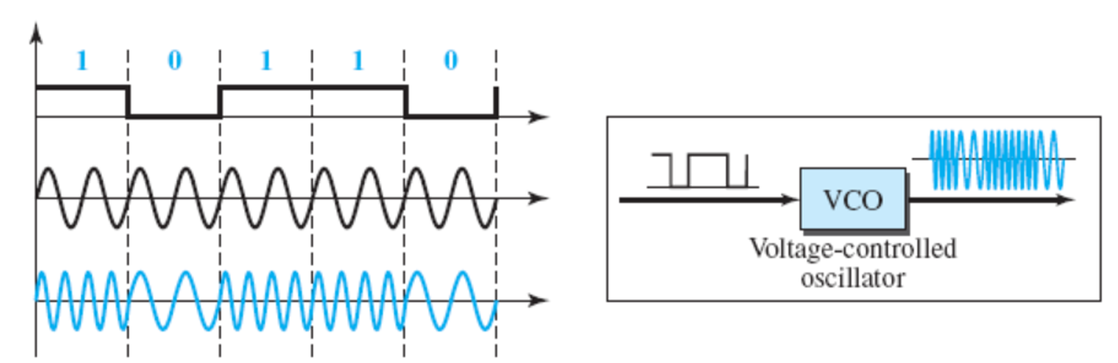
Implementation

Slide 34
Phase Shift Keying
In phase shift keying, the phase of the carrier is varied to represent two or more different signal elements.
Both peak amplitude and frequency remain constant as the phase changes.
Today, PSK is more common than ASK or FSK.
However, we will see shortly that QAM, which combines ASK and PSK, is the dominant method of digital-to-analog modulation.

Slide 35
Phase Shift Keying
2-PSK or Binary PSK (BPSK): uses 2 different phases (usually 0 and 180) each representing 1 bit of data => N = S
4-PSK or Quad PSK (QPSK): uses 4 different phases (e.g.; 45, -45, 135, and -135) each representing 2 bits of data => N = 2 S

Slide 36
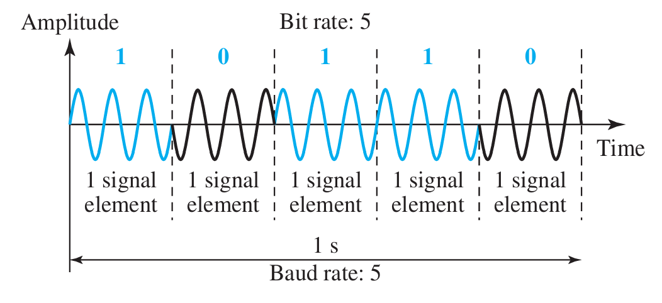
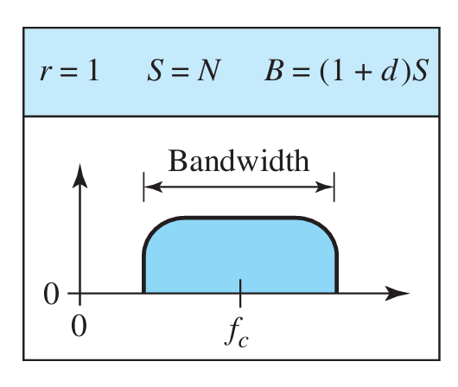
Binary PSK (BPSK)
The simplest PSK is binary PSK, in which we have only two signal elements, one with a phase of 0°, and the other with a phase of 180°.

Slide 37
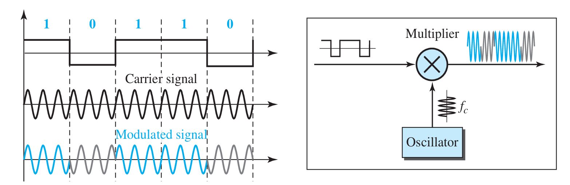
Implementation of BASK

Slide 38
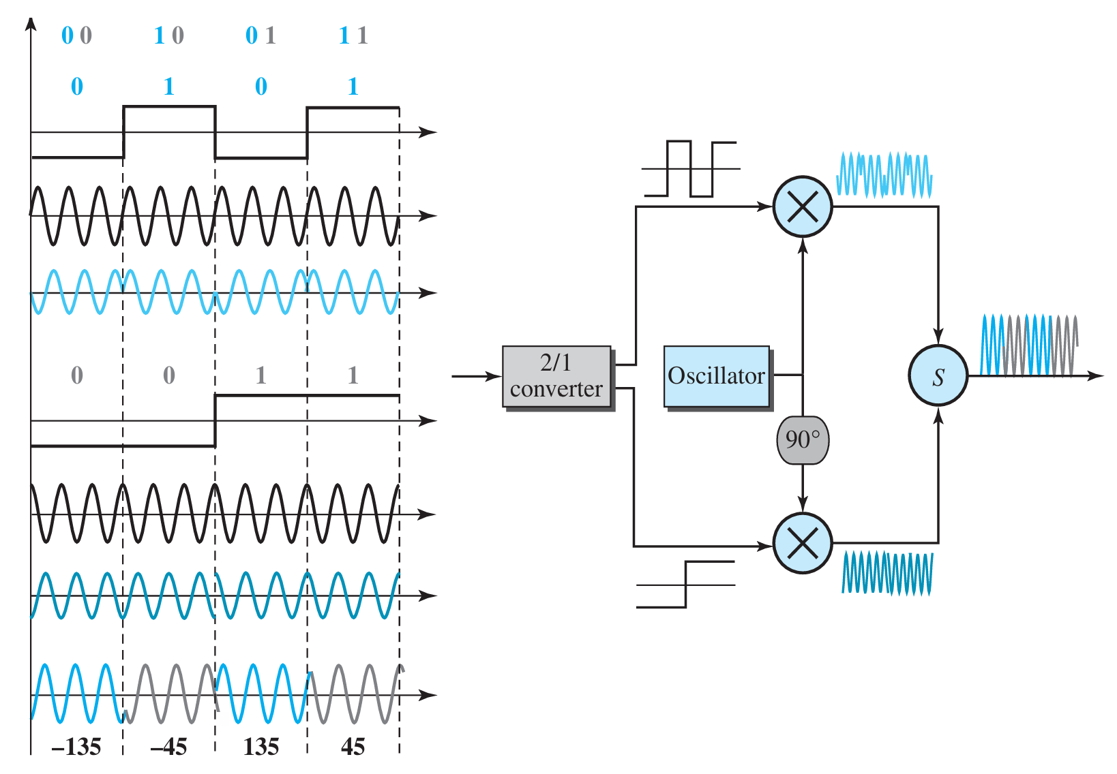
QPSK and its implementation

Slide 39
Example
Find the bandwidth for a signal transmitting at 12 Mbps for QPSK. The value of d = 0.
Solution
For QPSK, 2 bits is carried by one signal element. This means that r = 2.
So the signal rate (baud rate) is S = N × (1/r) = 6 Mbaud.
With a value of d = 0, we have B = S =6MHz.

Slide 40
Quadrature Amplitude Modulation (QAM)
QAM: varying both the peak amplitude and the phase of the carrier signal to represent binary combination
During each bit duration, the phase and amplitude remain constant.
Theoretically, any number of measurable changes in phase and amplitude can be combined to give several variations in the signal
The number of phase shifts is always greater than the amplitude shifts. Why?
The greater the ratio of phase to amplitude shifts, the better the noise immunity
QAM spectrum and bandwidth requirements are similar to ASK
Quadrature amplitude modulation is a combination of ASK and PSK.

Slide 41
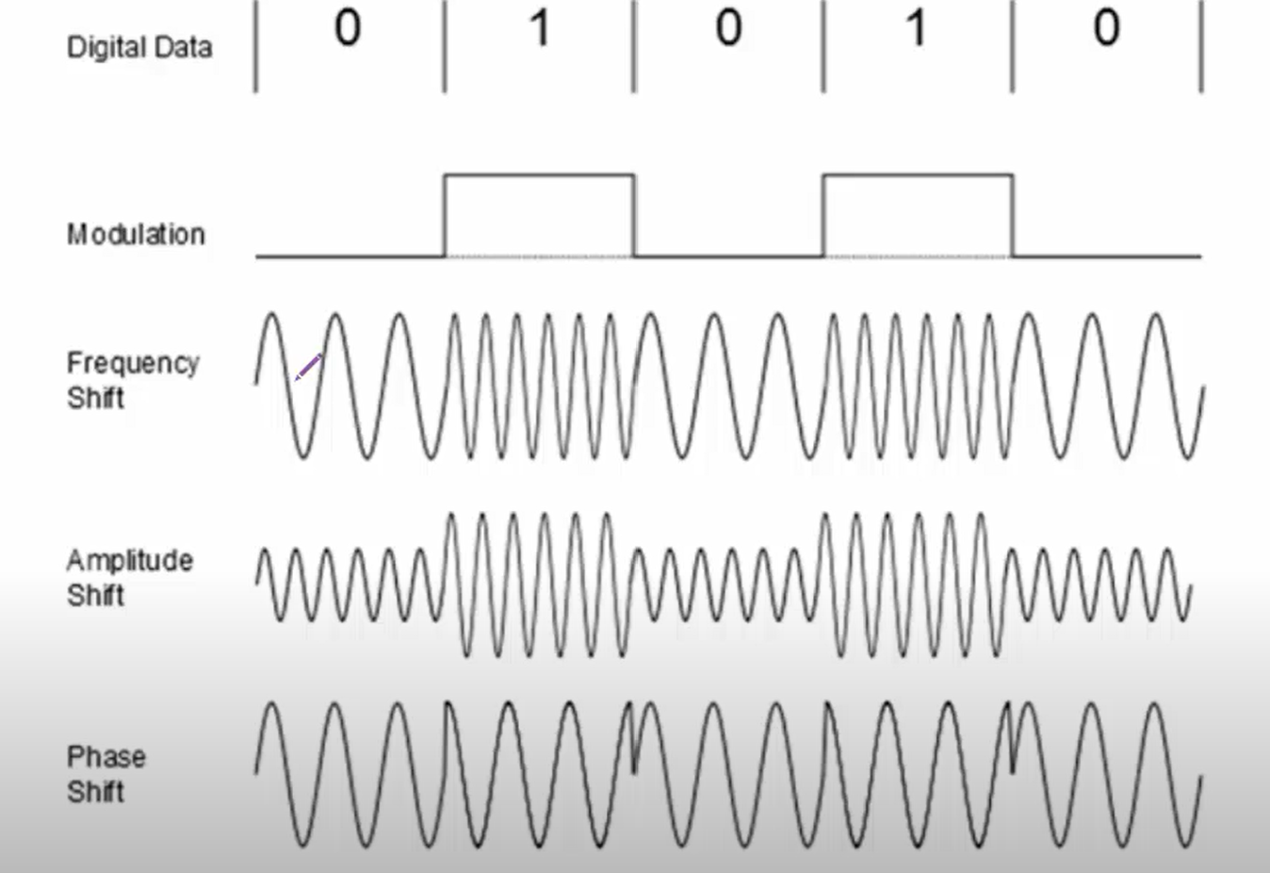

Slide 42
Exercises

Slide 43
True or False
The bit rate is always equal to the baud rate.
BPSK uses two phases: 0° for one binary state and 180° for the other.
Noise affects the amplitude of a signal more than its phase.

Slide 44
True or False
The bit rate is always equal to the baud rate.
BPSK uses two phases: 0° for one binary state and 180° for the other.
Noise affects the amplitude of a signal more than its phase.

Slide 45
Which of the following characteristics can be altered in digital-to-analog conversion?
a) Amplitude, Phase, Frequency
b) Speed, Bandwidth, Noise
c) Voltage, Current, Resistance
d) Data rate, Signal rate, Carrier frequency
Notes:
Answer: a

Slide 46
Which modulation technique uses two carrier frequencies for binary representation?
a) ASK
b) FSK
c) PSK
d) QAM
Notes:
Answer: b

Slide 47
Quadrature Amplitude Modulation (QAM) is a combination of:
a) ASK and FSK
b) PSK and FSK
c) ASK and PSK
d) PSK and amplitude modulation
Notes:
Answer: c

Slide 48
In ASK, if d=0, the bandwidth is equal to:
a) 2×S
b) S
c) S+d
d) 1+S
Notes:
Answer: b

Slide 49
Task

Slide 50
Compare the spectral efficiency of ASK, FSK, and PSK.
Which one is more efficient and why?

Slide 51
Practical

Slide 52
Project: Digital-to-Analog Modulation Simulator
Objective:
Simulate Amplitude Shift Keying (ASK), Frequency Shift Keying (FSK), and Phase Shift Keying (PSK).
Visualize the modulated signals based on given digital input.
Requirements:
Python 3.x
Libraries: numpy, matplotlib

Slide 53
How It Works:
Input: A digital data stream (e.g., [1, 0, 1, 1, 0]).
Modulation Techniques:
  ASK: Varies the amplitude of the carrier signal based on the data bit.
  FSK: Uses two different carrier frequencies for binary 0 and 1.
  PSK: Changes the phase of the carrier signal for binary 0 and 1.
Output: Visual plots of the modulated signals for each bit and technique.

